Slide 1
Real Estate Investment
LoopNet

Slide 2
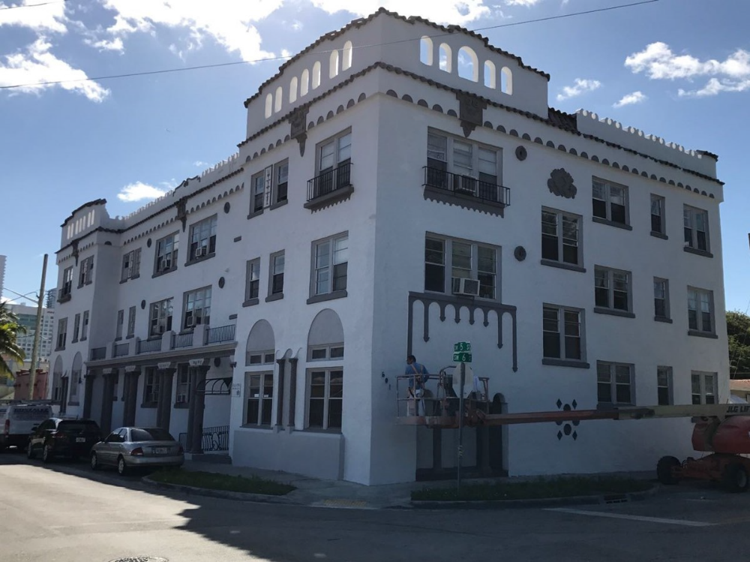

Slide 3
Executive Summary
From our analysis in Miami, we get to affirm the purchase of Villa La Pinta apartments that is a product of LoopNet. Did we not only see the investments value but also saw there is a growing demand for apartments in Miami. Miami has a huge number of urban homes and is populated mainly in the city. In addition to our findings, we get to see that the apartment's location is also a boost to us since it is near social amenities and the city. Our main target will be the working class.
This is because the working class get a sustainable income for their needs. We got a projection gross annual monthly of $3,679,200 by the eighth year and $4650750 a sell of the apartment by then. This will total up to $8329950. This shows that your return is $5829950 giving you a percentage return of approximately 70% from initial investments of $2500000. Having seen this, you get to see the exact value the apartment would bring in the long-term period making it valuable.

Slide 4
Market Research
According to Department of Number article, from the year 2015 statistics show that apartments in Miami Florida appreciate in demand from an average of 5.87% to 10.22%. This shows a 4.35% rise within three years. It also indicates that there is a rise in vacancy rates from – 0.85% to -1.88%. The rental vacancy rate simply refers to the fraction of homes not occupied.
This shows that with the growing trends it is most unlikely to stay one month without filling al the rental units. From the initial investments, we have a more likelihood of a tremendous rise in investments. According to the city data article, Miami has an estimated medium household income of $34,901 in 2016 from $23,483 recorded in 2000. Five and more housing unit that same financial year recorded revenues of $433,645 that made the medium gross rent for 2016 to be $ 1,063. It estimated that Miami urban area has is home to 5.5 million people according to World Population article review.

